Slide 1
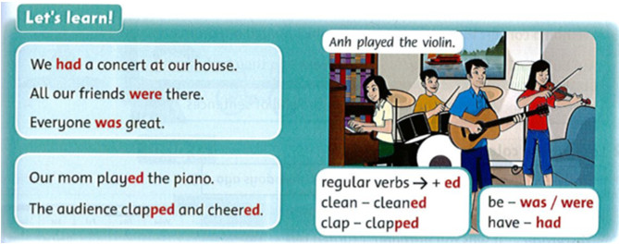
Monday , November 22nd 2021 Unit 4 : We had a concert Lesson 2
1. Listen to the story and repeat. Act.
2. Listen and repeat.
Click here to listen

Slide 2
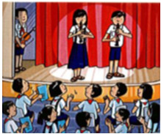
3. Read and circle.
Amy and Leo ¹ was / had a family concert. The concert ² were / was at home in Autralia. The children and their parents ³were/ played their instrument. Everyone in the audience ⁴listened to / was the music and ⁵enjoyed / had. It ⁶ was / were a really special day.
4. Write
enjoy be (x4) play (x2) cheer
Yesterday there ¹was a concert at school. Kim and Giang ² ___ on stage first. They ³_____ their recorders. Nam ⁴_____ next on stage.
He ⁵_____ his violin. The audience ⁶______ at the end. They all ⁷_____ the concert. It ⁸______ great!

